Slide 1
Lightning Talk 3: Self-Solving Rubik’s Cube
Taylor Burton, Jacob Campen, Casey Cierzan, Joe Crowley, Annie Lee, Patrick Levings-Curry, Luke Schoeberle
Notes:
Keegan
Hello, we are group 29 working on the Self-solving Rubik’s Cube and in this presentation we delve into the SOMETHING ABOUT TECHNICAL LIMITS

Slide 2
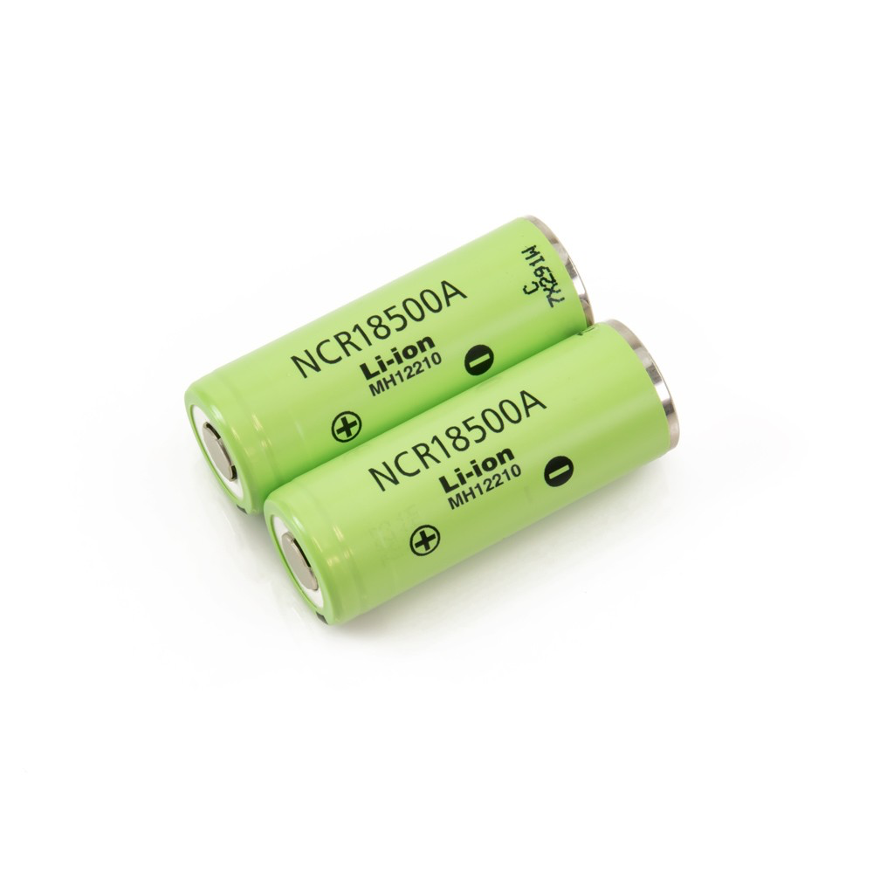
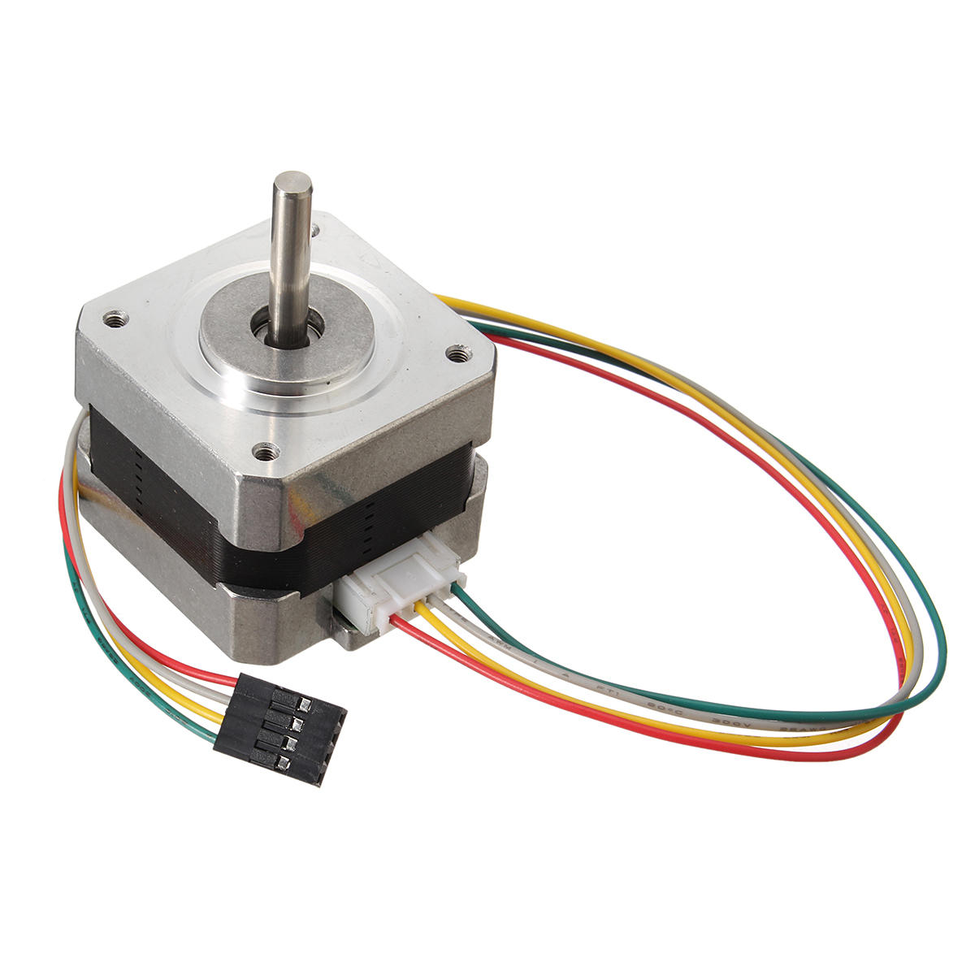
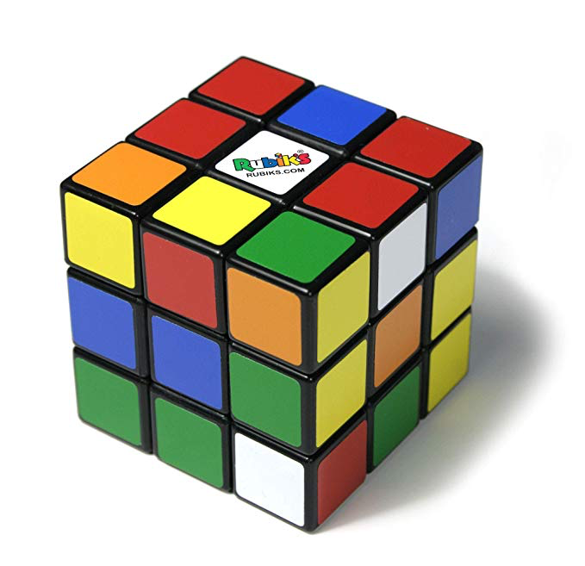
Technical Challenge - Hardware
Size
Stepper Motors
Battery Life
Notes:
The main challenge we are facing with the self solving rubiks cube is from a hardware standpoint. Because the goal is to create the final product as close to the size of a standard rubiks cube as possible, there is much miniturization to do. Our prototype that we are currently working on is about 3x the size of a standard cube, and even then there are several challenges. The main challenge is dealing with the negative space in the cube. There is only so much room to work with in a given shape, and this means that even with our large cube we only have about a 10 cm sphere. This leads us to the idea that our final cube will need to be custom 3d printed to achieve our goal. The size also limits the area for the stepper motors, which will move the faces of the cube. Smaller motors have less power, and since we are also not extremely well versed in the mechanical aspects of the motors, we have had to do some experimenting. With extremely small motors, the price also increases exponentially. Through some research we have identified and experimented with a possible size of motor, and have confirmed we can move the large cube. The bright side about this is we will have to use less power for a smaller cube, however, the motor will also have to be smaller as well. For the motor to function properly in our tests, we needed to make sure that there is ample current, and a normal battery was not working well. This leads us to the battery. Since our cube will be battery powered, there is reason for us to believe that the batteries will take up any and all extra room we have in the cube. This is another factor we have to consider, but will not know fully until we are able to miniurize our prototype more.

Slide 3
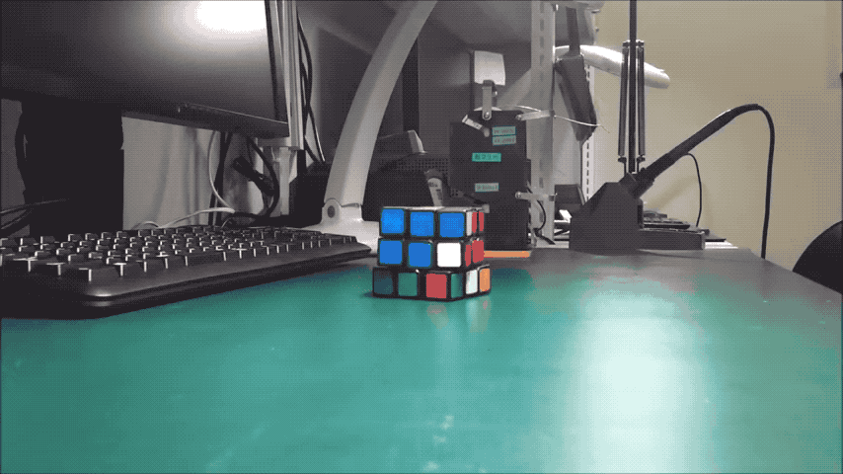
Technical Challenge - Software
Source: Takashi Kaburagi
Notes:
On the software side, our challenge is in optimizing the rotations that the cube will perform during its solve, as there are plenty of solving algorithms we could pick from if we didn’t care about the movement of the cube itself. As you can see in this short clip, a self solving cube will have to move around the surface it is on during its solve, and this can lead to the cube falling off table edges, threatening the integrity of our cube. Because there are numerous ways to solve a rubiks cube, we will be looking at finding or creating a solution that attempts to keep the cube in a confined area. While this may add additional rotations before leading to a full solve, it will create a better experience for our end user. This has been our largest ask from our client, so we will work to fill that need. For us, a perfect solution will lead to a cube that can solve itself with few turns, while also being able to stay in one area.

