Slide 1
Lightning Talk 2: Self-Solving Rubik’s Cube
Taylor Burton, Jacob Campen, Casey Cierzan, Joe Crowley, Annie Lee, Patrick Levings-Curry, Luke Schoeberle
Notes:
Hello, we are group 29 working on the Self-solving Rubik’s Cube and in this presentation we delve into the more administrative side of the project looking at our goals and the timeline along with what we hope to achieve by completing the project.

Slide 2
Technical Goals
Have the motors disengage with a clutch, allowing the cube to spin freely
Easier for the user to interact with
Increase lifetime of the motors
Solve the Rubik’s Cube Quickly
First prototype solve within 5 minutes
Second prototype solve within a minute
Easy to reprogram
Have it so that new program can be uploaded without complete disassembly
Easy to replace the batteries
Make its so that batteries can be replaced without complete disassembly
Notes:
Taylor

Slide 3
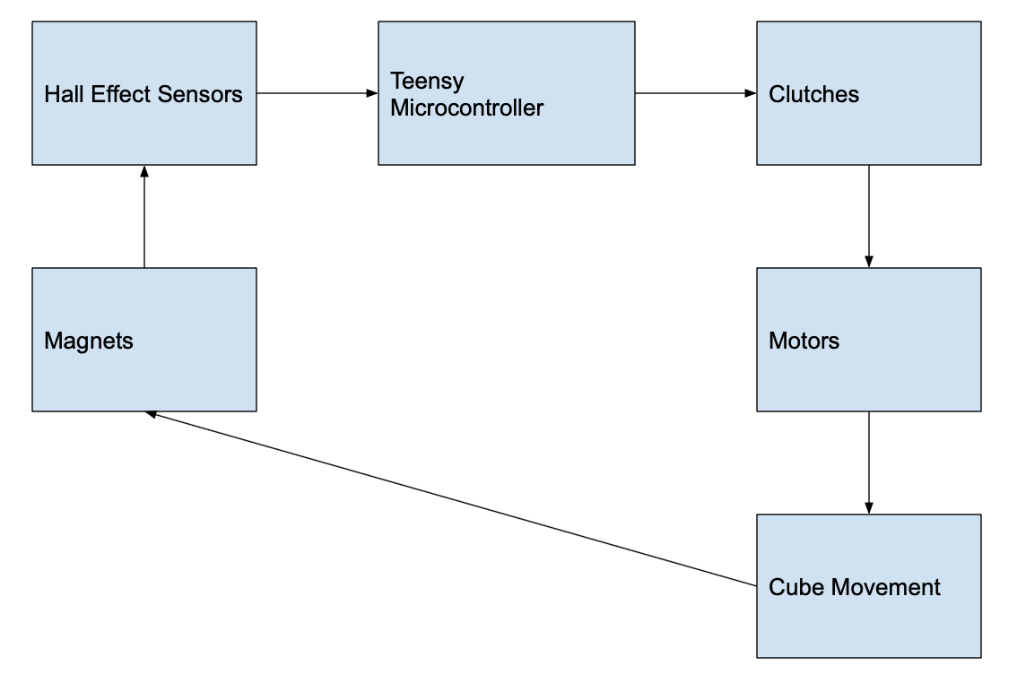
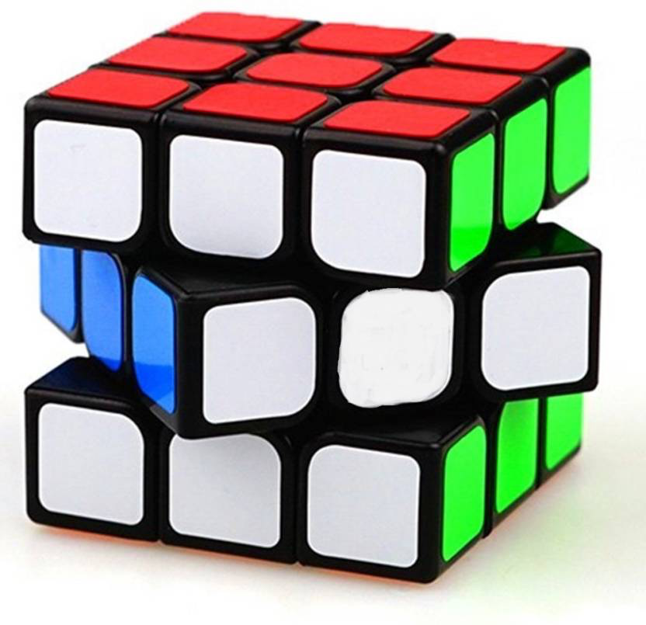
System Overview
Notes:
Jacob
Not much to be said, just show the looping nature of the system and how each interacts.

Slide 4
Timeline
First prototype (Large-sized cube):
Parts and algorithms research
Hardware installation to cube
Algorithm + movement control testing
Second prototype (Regular-sized cube):
Hardware installation to cube
Testing + adjustments
Final optimization
Notes:
Annie-
The timeline of our project will be divided to two main parts: The first part using a large-size cube, and then moving on to implementation on a regular-sized cube. The reason behind this timeline arrangement is to reduce the difficulty of integrating parts into cube at the beginning. Initially, we will be doing research on hardware parts to use as well as solving algorithms to perform. Then, we will be implementing the parts to the large cube. After assembling, we will do testings on the movement of cube, and performance of solving algorithms. After having a well working large cube, we can utilize the design of the first prototype to create regular-sized self-solving Rubrik's cube. We will be adjusting the hardware installation process to fit all components. Then, repeat the testing of interaction with cube to make solving performance better. After having a working second prototype, we will spend the rest of time optimizing user experience.

Slide 5
Outcome
Self-Solving Rubik’s Cube
Streamlined Design Process
Experience Working with a Team
Notes:
Joe - By following this timeline, we will be able to reach our end goal of creating a self-solving Rubik’s cube. This will be achieved by sticking to our design process of defining our problem, brainstorming solutions, researching and testing those solutions, presenting our design to our client, and refining if the client doesn’t deem our solution as successful. As we go through this process, we will be taking out the unnecessary parts in order to create a streamlined design process. We will be able to take this design mentality into the workplace after graduation to be dependable team members. Apart from the physical deliverable of our project, we will be gaining many soft skills that will make us more employable and give us opportunities to work on a large project with a team. Our self-solving Rubik’s cube will allow us to holistically showcase the output of our education at Iowa State.

